Slide 1

Walmart Data Analyst Project
By
Giridharan Kannan

Slide 2
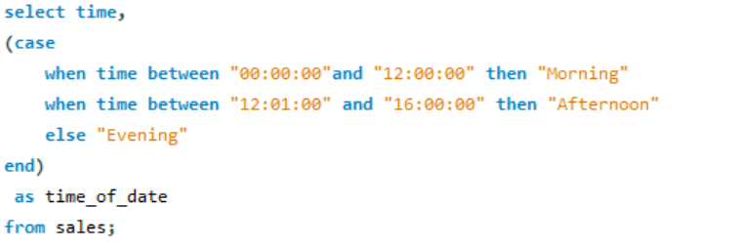
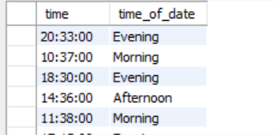
1. Add the time of the day:
Query:
Output:

Slide 3
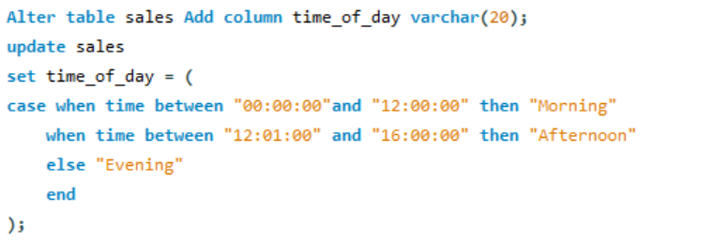
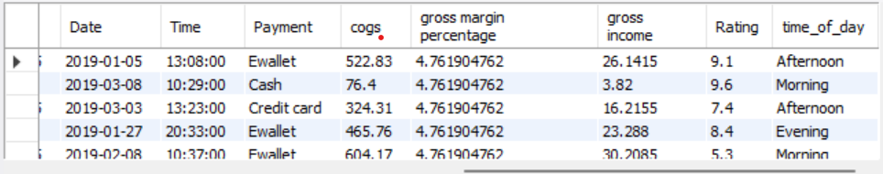
2. ADD a new column and update a new column
Query:
Output:

Slide 4
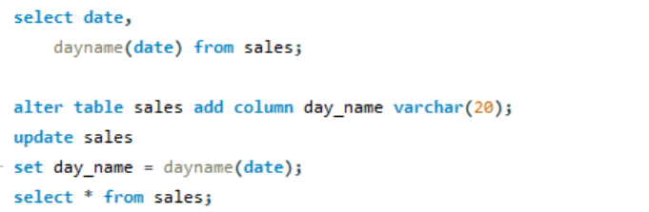
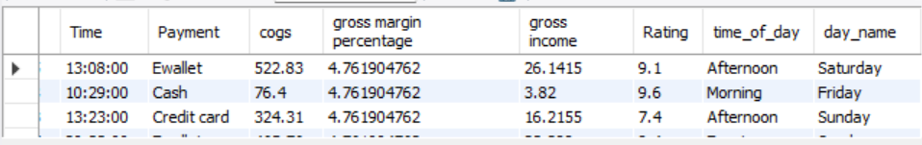
3. Add new day_name column:
Query:
Output:

Slide 5
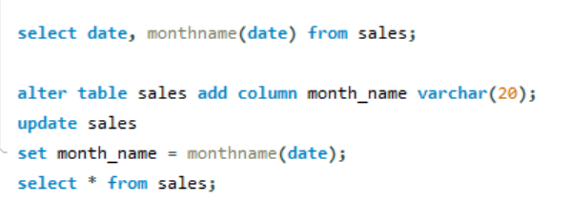
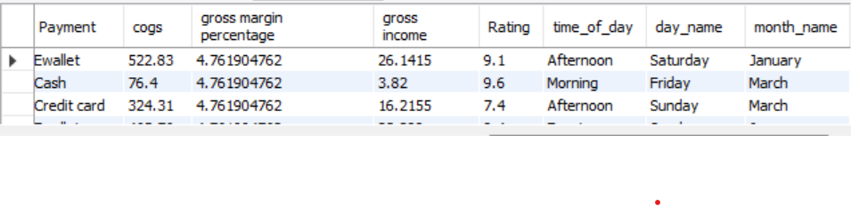
4.Add a new column name Month_name:
Query:
Output:

Slide 6
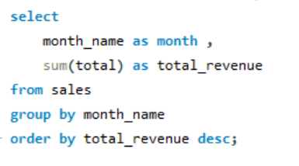
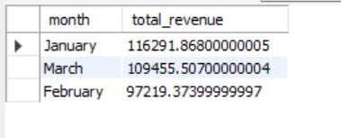
5. Total revenue by month
Query:
Output:

Slide 7
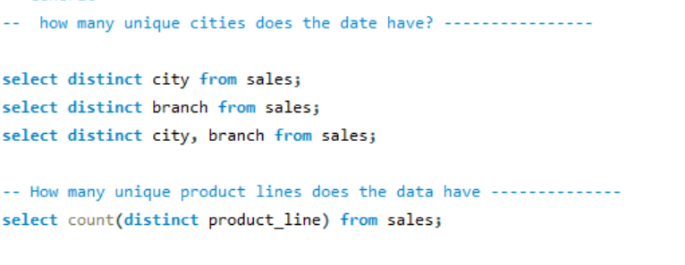
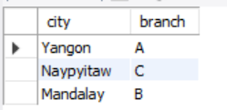
6.Unique values cities and branches:
Query:
Output:

Slide 8
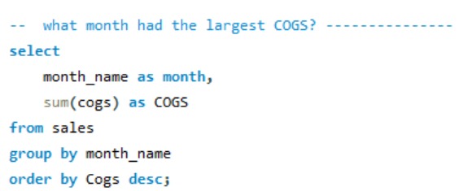
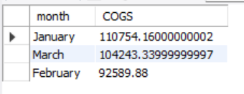
7.What month had the largest cogs:
Query:
Output:

Slide 9
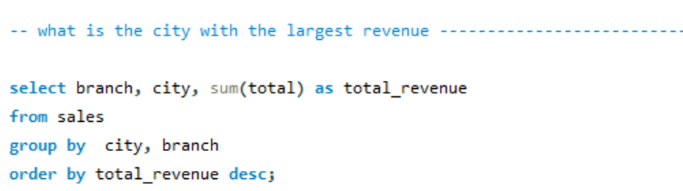
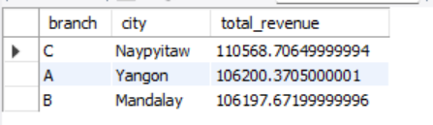
8. What is the city with largest revenue:
Query:
Output:

Slide 10
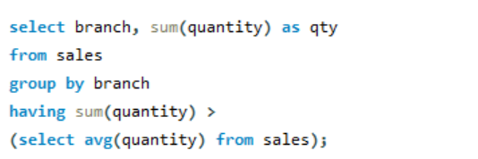
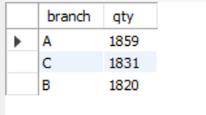
9. which branch sold more products than average product sold:
Query:
Output:

